Slide 1
WS-DAI RDF(S) Specification
OGF28 DAIS Working Group
Isao Kojima
Information Technology Research Institute
AIST
Japan

Slide 2
OGF IPR Policies Apply
“I acknowledge that participation in this meeting is subject to the OGF Intellectual Property Policy.”
Intellectual Property Notices Note Well: All statements related to the activities of the OGF and addressed to the OGF are subject to all provisions of Appendix B of GFD-C.1, which grants to the OGF and its participants certain licenses and rights in such statements. Such statements include verbal statements in OGF meetings, as well as written and electronic communications made at any time or place, which are addressed to:
the OGF plenary session,
any OGF working group or portion thereof,
the OGF Board of Directors, the GFSG, or any member thereof on behalf of the OGF,
the ADCOM, or any member thereof on behalf of the ADCOM,
any OGF mailing list, including any group list, or any other list functioning under OGF auspices,
the OGF Editor or the document authoring and review process
Statements made outside of a OGF meeting, mailing list or other function, that are clearly not intended to be input to an OGF activity, group or function, are not subject to these provisions.
Excerpt from Appendix B of GFD-C.1: ”Where the OGF knows of rights, or claimed rights, the OGF secretariat shall attempt to obtain from the claimant of such rights, a written assurance that upon approval by the GFSG of the relevant OGF document(s), any party will be able to obtain the right to implement, use and distribute the technology or works when implementing, using or distributing technology based upon the specific specification(s) under openly specified, reasonable, non-discriminatory terms. The working group or research group proposing the use of the technology with respect to which the proprietary rights are claimed may assist the OGF secretariat in this effort. The results of this procedure shall not affect advancement of document, except that the GFSG may defer approval where a delay may facilitate the obtaining of such assurances. The results will, however, be recorded by the OGF Secretariat, and made available. The GFSG may also direct that a summary of the results be included in any GFD published containing the specification.”
OGF Intellectual Property Policies are adapted from the IETF Intellectual Property Policies that support the Internet Standards Process.

Slide 3
Outline
Overview and the Status of the Activity
Motivational Doc is Published as an OGF informational Doc.
Waiting for the finalization of WS-DAI Core
Specifications Introduction
Query Spec.
Ontology Spec.
We don’t have much progress on them,,
Discussions

Slide 4
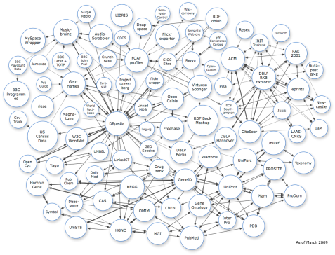
WS-DAI-RDF(S) Standard Structure
What is all about?
Providing an access mechanism to RDF(S) data resources
RDF(Resource Description Framework)
Common Data Representation in the Semantic Web area
RDF(S) = RDF Schema
The number of RDF resouces is increasing worldwide
(billions of triples)
New WS-DAI realization for RDF(S) data
which will consist of 2 complementary specifications
RDF(S) Ontology Access
Ontological Primitives
based on RDF(S) model(as Class)
RDF(S) Querying
Query Language(SPARQL)
for Instances
Use either or both
according to your needs

Slide 5
DAIS for RDF: History
2006.02: GGF16 at Athens
DAIS for RDF BOF: Share the Motivation
2006.05: GGF17 at Tokyo
Charter Discussion
Focus on RDF and RDF Schema (RDF(S))
Scope/Roadmap/Deliverables
2006.06: RDF F2F at Edinburgh
Decide to make an informational document
Motivational Document : Structure Discussion
2006.09: GGF18 at Washington
Motivational Doc Presented
2007.02：OGF19 at Chapel Hill, NC
2 initial Specification Documents Presented
2007.05: OGF20 at Manchester
Initial version of the “Glossary of the Terms” is presented
More Use Cases Presented.
2007.09：OGF21 at Seattle
Documents updated
Glossary of Terms
Executive summary for Querying spec is presented.
Roadmap/Schedule is revised
2008.02:OGF22 at Boston
Agreed Terms Presented
Documents updated
2008.06:OGF23 at Barcelona
Documents updated
Charter is updated
2008.09:OGF24 at Singapore
Status Updated
2009.02:OGF25 at Catania
Status Updated
Roadmap Rescheduled
2009.09:OGF27 at Banff
Motivational Doc Submitted &
went into Public-Comment Phase

Slide 6
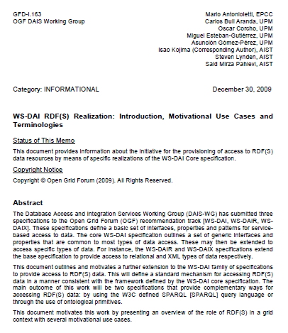
Progress after OGF27
Motivational Document is Published as an OGF Informational Document ( 30th ,Dec. 2009)
WS-DAI RDF(S) Realization: Introduction, Motivational Use Cases and Terminologies
GFD.163 (http://www.ogf.org/documents/GFD.163.pdf)
- In order to advertise our activity
Introduction
Use Cases
New from ADMIRE Group
Agreed Terminology
Extracted from our old in-discussion
“Glossary of Terms” doc

Slide 7
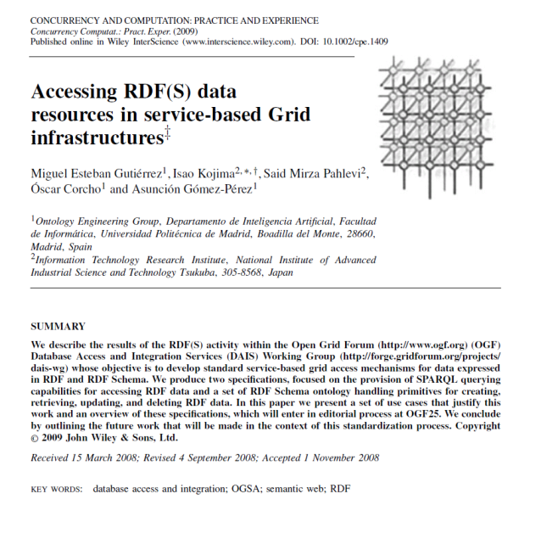

Related info
Our Journal Paper is also published.
M.Esteban, I Kojima et al.
“Accessing RDF(S) Data Resources in
Service-based Grid Environment”
In the OGF Special Issue of
“Concurrency and Computation”
Journal Vol.21. No.8. June 2009 issue

Slide 8
Usecases – Semantic Web & the Grid
Query-based Semantic Matchmaking
for Grid Resources
Grid Resource Monitoring & Annotation
Distributed SPARQL Processing for
Distributed Metadata for RFIDs
Aggregation of Heterogeneous Grid Resource
Metadata

Slide 9
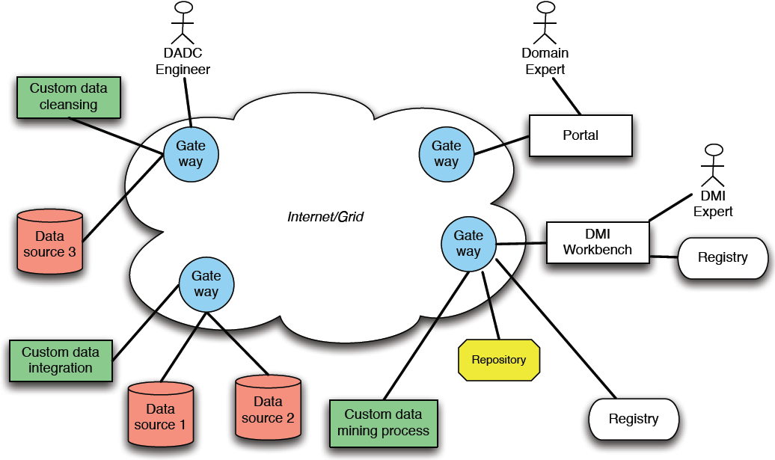
Latest Usecase
ADMIRE (Advanced Data Mining and Integration in Europe) Project
Resource Registry
Manages distributed metadata of “Processing Element”
SPARQL is used to discover “P.E.” resource.
local and/or global

Slide 10
Terminology
RDF(S) Data Resource
Data source/sink that is based on the RDF data model + management infrastructure which may exhibit RDF(S) model based views
Relationships of Terms between 2 specs.
Ontology Querying
Repository ←→ RDF Graph
A set of RDF Triples
RepositoryCollection ←→ GraphCollection
A set of Repositories or RDF Graphs = RDF(S) Data Resouce

Slide 11
Terminology
views it as
a GraphCollection
RDF(S)
Data
Access
Service
SPARQL
Access
M
D
F
RDF(S) Data Resource
a
R
n
D
a
Data
Source/
Sink
a
g
e
t
m
a
e
RDF(S)
Data
Access
Service
n
RDF(S)
Model
t
M
l
Ontology
Access
I
o
d
e
n
f
r
a
views it as
a RepositoryCollection
The naming duality is due to the way in which each specification views the RDF(S) data resources
(The location transparent names via an End Point Identifier (EPI) can be used to identify the resource sameness)

Slide 12
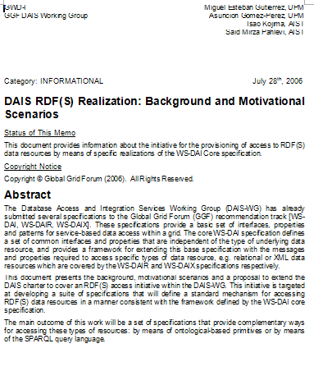
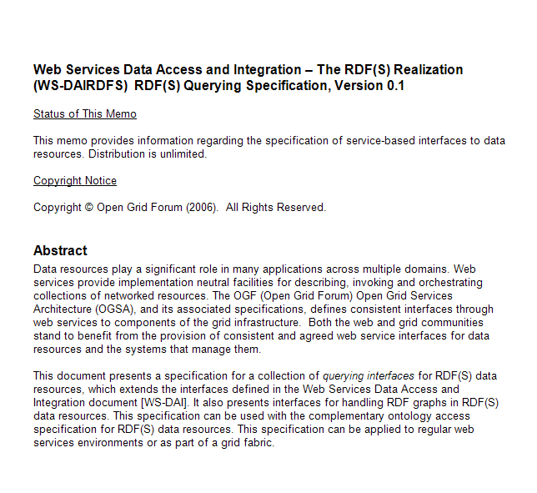
Current Documents
2 spec documents are on the forge
Other documents are merged and published as GFD-I-129.
DAIS RDF(S) Background & Motivational Scenarios
WS-DAI RDF(S) Querying
WS-DAI RDF(S) Ontology Access
Glossary of Terms
5 . Executive summary of Querying Specification
Query Spec is almost stable
No Major Improvement from OGF24!
Ontology Spec still need to be concised
Still work in Progress

Slide 13
WS-DAI (Core & Relational) Interop Testing &Query Specification
Our WS-DAI RDF(S) implementations which supports Core
We found an implementation problem when using JAXB.
We could not generate DataResourceAddressType in factory pattern
JAXB creates EPR Type as a final class and extending it is impossible
ADMIRE Group, who is also doing the another implementation is facing with the same problem.
We need to replace DataResourceAddressType with EndPointReferenceType in the factory pattern of WS-DAI Core.
Proposal is included in the InteropTest Doc(GFD.160).
7.1 changes to the WS-DAI core document (17)
Implementation will be restarted &completed if accepted
(as presented later).
Querying specification should be adjusted based on the final WS-DAI Core.

Slide 14
WS-DAI RDF(S) Querying Specification Discussions
OGF28 DAIS Working Group

Slide 15
Querying Specification Overview
Direct and Indirect Access for RDF data using SPARQL
Based on the WS-DAI core model
Direct
Access
Consumer
SPARQLExecute(DataResourceAbstractName,
DatasetFormatURI
SPARQLQueryRequest)
RDF(S) Data Access Service
SPARQLAccess
SPARQLExecuteResponse(
Dataset)
Indirect
Access
Consumer
SPARQLExecuteFactory (DataResourceAbstractName,
PortTypeQName,
ConfigurationDocument,
SPARQLQueryRequest )
SPARQLAccessDescription
SPARQLFactory
Reference to SPARQL Query Results
SPARQLItemsSetDescription
GetResults
(StartPosition,ResultCounts )
Results
SPARQLResultsSetAccess

Slide 16
Querying Specification Status
Seems to be Almost Stable
AIST Implementation is ongoing
Based on our OGSA-DAI-RDF
Implementing with JAXB
Waiting for the publication of the final WS-DAI Core
Basic pattern is OK if EPR is used(as presented later).
ADMIRE Implementation is ongoing
Also based on OGSA-DAI

Slide 17
Implementation: OGSA-DAI RDF
A Set of RDF Processing Activities & Utilities
http://dbgrid.org/OGSA-DAI-RDF
V1.0 (DAI2.2 based) is available
V2.0 (DAI3.0 based. 3.2 is also supported)
Currently public as Technical Preview
Used for limited applications
Monitoring database of S-MDS
Records history of monitoring data with OWL
Rule based statistical Processing
Service Repository of AIST Semantic SOA
Service Workflow is represented with RDF and stored.
Federated SPARQL prototype(ongoing)

Slide 18
WS-DAI RDF(S) Querying AIST Implementation Status
WS-DAIRDF(S) Querying with JAXB
OGSA-DAI RDF2.0(with OGSA-DAI 3.2) Jena2.6
Basic Pattern is already Implemented (assuming the use of EPR)
GetPropertyDocument: Get Metadata of the Resource(WS-DAI Core)
SparqlExecute : Execute SPARQL Query (Direct Access)
SparqlFactory: Execute SPARQL Query(Indirect Access)
GetItemsSetPropertyDocument: Get Metadata of the ResultsSet
GetResultsSet: Get Records from the ResultsSet

Slide 19
Discussion before Submission
Adjust the spec based on the final WS-DAI
Confirm the Spec.
No more Metadata?
Get feedback from ongoing Implementations
Find and/or Clear the ambiguity of the spec

Slide 20
WS-DAI RDF(S) Ontology Access
OGF28 DAIS Working Group

Slide 21
Introduction Goal & Objectives
Goal:
“To provide access to RDF(S) data sources in a grid fashion, without constraining what the user could manually do (specially when serializing a local RDF/XML file), and facilitating common tasks, providing a highly flexible and adaptable access mechanism that hides technicalities of RDF(S) to the user, whilst transparently exploits its full semantics”
Objectives:
Full RDF(S) coverage
R+W capabilities
Granular data access
Resource centric API

Slide 22
Overview Data Resources Types & Organization
Convenience abstractions
Class placeholders
Class placeholder

Slide 23
Overview Concepts, revisited Resource lifecycle
Creation:
Explicit: a triple is created with the resource as subject.
Implicit: a triple is created with the resource as predicate or object.
(Property value) Attachtment:
Explicit: adding a new triple which uses an already existing resource as subject.
Implicit: adding a triple which uses an existing resource as predicate or object, and due to RDF(S) entailment rules, new property values are automatically attached.
(Property value) Detachment:
Explicit: removing a triple which has the resource as subject.
Implicit: removing a triple that has the resource as predicate or object, and as a result inferred property values are lost (no longer explicit).
Removal:
No triples using the resource exist.

Slide 24
Overview Interfaces Organization
Native interfaces
Utility interfaces

Slide 25
Overview Interfaces Summary
86
Messages!

Slide 26
Overview Profiles
WS-DAI-RDF(S)
Ontology Realization
StatementAccess
ContainerAccess
ContainerFactory
ContainerIterator
AltAccess
ListAccess
ListFactory
ListIterator
Statement
Container
List
Profile 2:
Full RDF(S) Support
ClassAccess
PropertyAccess
Profile 1:
RDF Schema Support
Class
Property
Profile 0:
Basic RDF Support
RepositoryCollectionAccess
RepositoryCollectionFactory
RepositoryAccess
RepositoryFactory
ResourceAccess
RepositoryCollection
Repository
Resource

Slide 27
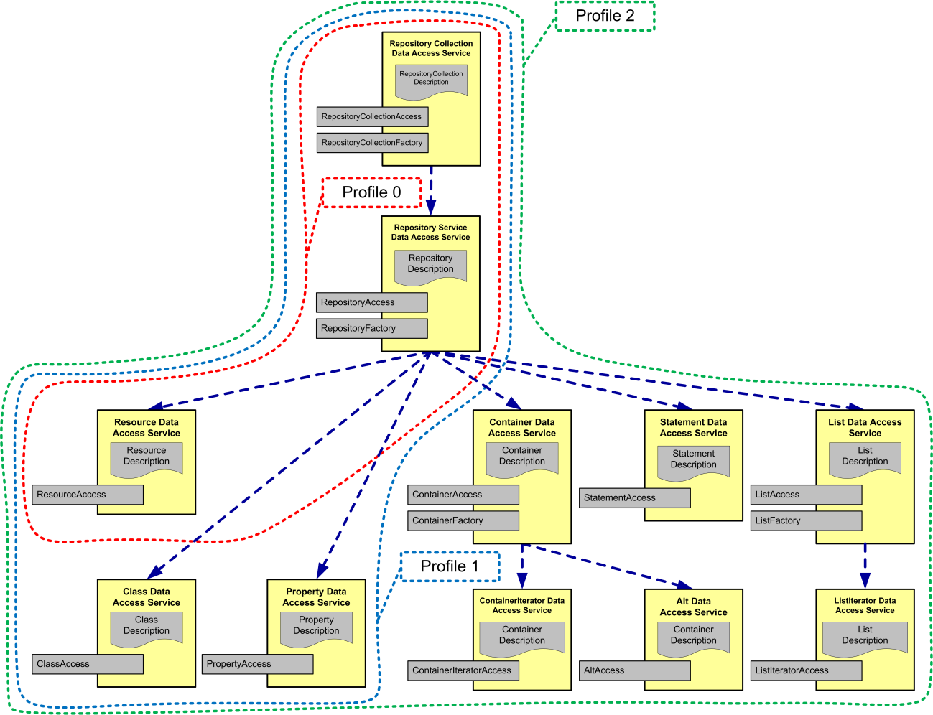
Class Hierarchy and the Profiles

Slide 28
Current Status Profile 0 Summary
21
2

Slide 29
Ontology Access
Still need to be concised by parametarizing APIs
RoadMap/Timeline is undefined
More contributors wanted.

Slide 30
Discussions?

